Slide 1
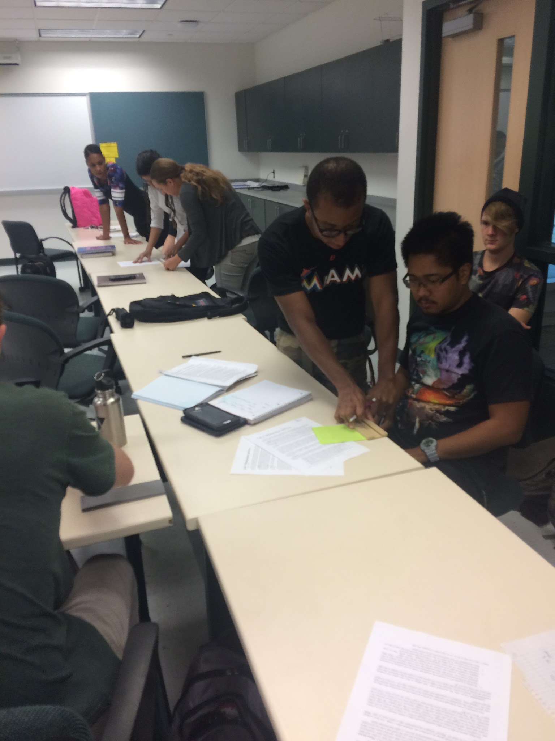
A Qualitative Study of “Computational Geology” at USF – A Quantitative Literacy Course Preparing Undergraduates for the Workforce since 1996
Victor J. Ricchezza and H.L. Vacher University of South Florida School of Geosciences
Introduction
GLY 4866, “Computational Geology,” is a Quantitative (capital-Q) Literacy course that has been offered annually to undergraduate geology majors at the University of South Florida in Tampa since 1996. The course, which has had a Calculus-1 prerequisite, focuses on problem solving in a geologic context, with a goal of improving student comfort with numeracy (numbers, equations, and calculations), quantitative literacy (verbal and graphic communication), and quantitative reasoning (critical thinking habits of mind). Recent meetings and surveys (e.g., the Summits on the Future of Undergraduate Geoscience Education^{1,2}) have identified similar skills and habits of mind as being vital for geology undergraduates to learn. In “Alumni Narratives on Computational Geology (Spring 1997 – Fall 2013) (Ricchezza 2016), ten professionally successful course and program alumni, who took the course between spring 1997 and fall 2013, were given anonymity and interviewed about their memories of the course, how they have used the material since graduating, and what they now would suggest students should learn. This presentation collects our findings on how the course has prepared those alumni for work. Interviewees included public sector regulators (3), private sector environmental consultants (3), and a mix of instructors and graduate students in academia (4). All individuals and groups reported using what they learned in the course extensively since graduating – including in their personal lives. Interviewed regulators consistently mentioned frequent use of unit conversions and Microsoft Excel spreadsheet skills. Academics outlined – in unique and colorful stories – how they internalized what they learned and have adapted it into what they teach. Consultants exhibited a mixture of the other two groups’ outcomes, along with a heavy emphasis on the ability to communicate and organize numbers and data. Detailed quotations are extracted from the transcripts to illustrate answers to the “What?” and the “How?” of the use of the course material in these alumni’s subsequent professional careers.
In this presentation we have focused primarily on the response to the second structured question: is there anything from the course that you have used professionally or personally since graduating? We have further narrowed that focus to the professional uses these alumni discussed and direct statements they made regarding the impact the course had on their careers.
Common themes in the interviews included the use of spreadsheets/Excel to solve problems and manage large data sets, correct conversion of units, effective communication about numbers and quantities, thinking logically, and learning to be empowered by the tools offered by mathematics rather than being fearful of them.
Results
Is there anything from the course that you used professionally or personally since graduating?
John Doe, M.S., Consultant, Fall 2012
“I definitely use a lot of Excel, so the little tips and tricks, when it came to solving problems with Excel, were definitely useful and [I] continue to gain knowledge in Excel every day, so, especially when it comes to solving problems with brute force, Excel can be a very important tool for that.”
Sam, B.S., Regulator, Fall 2011
“It was really more of a basic understanding of how to use Excel, how to use the different functions in Excel, how to set up equations… one thing that was really helpful was knowing how to manipulate entire columns of data. That’s something I definitely learned in that class.”
Arya, M.S., Academic, Fall 2011
“I TA some classes like Sedimentology… we have to do weighted averages and they have trouble with Excel. And I say I can give you something to help you with that, and I give them those tutorial modules or something like that to help them.”
“I felt like it gave me a little bit more of a starting point because… I was not very strong in statistics, so with not having a strong statistical background and doing a [MS] thesis that’s just highly related to statistics… I was able to go back and use my notes.”
Sunshine, M.S., Academic, Fall 2006
“Last week I made an Excel spreadsheet for one of my students who was going to fail… she just stopped coming, this was her second time taking the lab… and I knew there were things going on. So I gave her a W, and I… created an Excel spreadsheet of the labs she has turned in, the quizzes she has turned in… and I color-coded for the ones she could manipulate to see what she would need to get on the labs and the quizzes to get the grade that she wanted at the bottom. So at the bottom I had her weighted grade calculated so it would change whenever she changed those cells. And that’s all stuff I learned from computational geology.”
Gilda, B.S., Regulator, Fall 2008
“Yes, I think I have probably used every single Excel function that Dr. Vacher showed us.”
“If there’s ever any sort of question, I’ve gotten used to just drawing a picture and labeling everything in order to better understand what to do to solve it. And unit conversions, that probably helped a lot too.”
“The relevance for my everyday job would probably be using the same problem solving skills that we learned… I’m never going to have to try to solve the same exact problems he presented, but I can use the same steps that he showed us in order to solve whatever I might run into.”
Medusa, M.S, P.G., Consultant, Spring 1997
“It allowed me to see mathematics as a tool that I can realistically use in the applications of geoscience instead of viewing calculus etcetera as a separate thing from geology.”
“I learned how to actually apply these things. But at the same time, it really was learning how to think about these concepts, learning what the computations mean, learning how mathematics is a tool. And learning the pitfalls of that.”
“The geochemistry I learned [in graduate school] and the spreadsheets and hydro that I learned from Len Vacher are definitely the primary sources that I use in my work now.”
Results
Luke, M.S., Regulator, Fall 2009
“I really learned a lot about Excel in that class, and it’s not just a class about learning how to do math correctly, it’s a lot of being able to use the tools, the modern day tools, that we now have, like Excel. So I learned a lot about Excel… I can look through a sheet and reverse engineer it, find out the calculations, things that people have submitted to me.”
John Smith, M.S., Consultant, Fall 2011
“I remember it being extremely challenging, but informative, and in the end, a very beneficial course for me.”
“Everything we did in that class… still benefits me to this day. That class really instilled in me a sense of… thoroughness… there’s always something lurking in the shadows that you need to address… when a problem comes up.”
“This is going to carry you through the rest of your degree and the rest of your life, your career if you take it in, learn how to think, learn how to solve a problem. It’ll help you, you know? (…) It gave me a work ethic. (…) The tenets of that course carry over and apply to everything. Everything!”
“Definitely the Excel work. For sure… I live and die in Excel at my job. (…) I write the reports, I do the tables, I do… the analysis… but so much of that is made easier from knowing how to use Excel and knowing how powerful it can be. (…) I’ll write my reports with pen and paper if you want me to, but if you take Excel away from me, I’m dead. I don’t want to come to work.”
“I’ve become a more analytical person because of it, you know?”
Jam, M.S., Academic, Fall 2001
“Yeah, a lot. I make my students do Excel exercises. I want my students to be quantitatively literate.”
Lee, B.S., Academic, Fall 2013
“Every day. Every single day. (…) I use Excel, I use computations every single day. It was really eye-opening to get to grad school and be among… primarily my department is a research department. It’s interesting when I got here to see it, the focus was way more on computation than I ever gathered when I was at USF. Showing with numbers why you’re saying it’s true, or why it’s a good hypothesis. I try to apply numbers to things that I’m doing every day.”
“I managed a large data set.”
“I use percent differences and the statistics he went over, Excel formulas and arrangements, all the time.”
“It was a helpful skill that I learned in Dr. Vacher’s class, because he took great care in teaching you how to think through problems, as in, what’s your question, what’s your plan? In your plan, is like, Polya or something? (…) It’s so beautifully simple, and if you actually do it, it is incredibly helpful. (…) So, as far as like, the skill from Dr. Vacher’s class, learning not to be overwhelmed by just a screen full of numbers on your computer, taking a step back and thinking about, ok, well, what am I trying to do here, how am I going to do it, what is the best way that I can present this number, or these numbers, or just this overall data collection in the best way that would make sense to somebody else who’s going to look at it? (…) That was his entire course, was just learning how to think things through logically in a step by step manner.”
Conclusions
Medusa phrased the most important questions gleaned from the course as “so what?” and “who cares?” and we have applied those to this project. We came away with the following answer – this course has produced graduates who are quantitatively literate within a variety of geologically oriented professions. Although the list of professions chosen was not exhaustive, the spread of such careers clearly demonstrates that the skills, competencies, and habits of mind that are the desired student learning outcomes of the Computational Geology course not only show retention after a long span of time, but are also not specific to a single job.
The competencies or skills that are taught in this course include the ability to perform calculations, solve problems, communicate numerical results, and to use Excel proficiently to accomplish these goals. The data generated in this study indicates that for this (admittedly limited and purposefully selected) sample group, the skills are still present 3-17 years after graduation. The habits of mind desired as outcomes include critical thinking and understanding why to use some problem solving methods over others.
Further proposed studies include USF alumni and national survey(s) to determine how programs prepare students with the quantitative skills they need for career success.
Selected References
Polya, George 1945. How to Solve It.
Ricchezza, Victor J. 2016. “Alumni Narratives on Computational Geology (Spring 1997 – Fall 2013),” Graduate Theses and Dissertations.
Vacher, H.L. 2000. "A course in geological-mathematical problem solving." Journal of Geoscience Education 48 (4):478-481.
1 http://www.jsg.utexas.edu/events/future-of-geoscience-undergraduate-education/
2 http://www.jsg.utexas.edu/events/files/Survey_NSF_report.pdf
Further information
This poster includes information from the primary author’s MS thesis (2016). For more information on this project, or the author’s other work, scan the QR code or visit http://vicricchezza.weebly.com/thesis.html.
Vic Ricchezza: Ricchezza@mail.usf.edu Len Vacher: Vacher@usf.edu
Notes:
Copyright Colin Purrington (http://colinpurrington.com/tips/academic/posterdesign).

