Slide 1

“Computational Geology” at the University of South Florida Prepares our Geology Majors for the Transition to the Workforce: How our Course Does It and How We Know It Does
Victor J. Ricchezza and H.L. Vacher
University of South Florida School of Geosciences

Slide 2

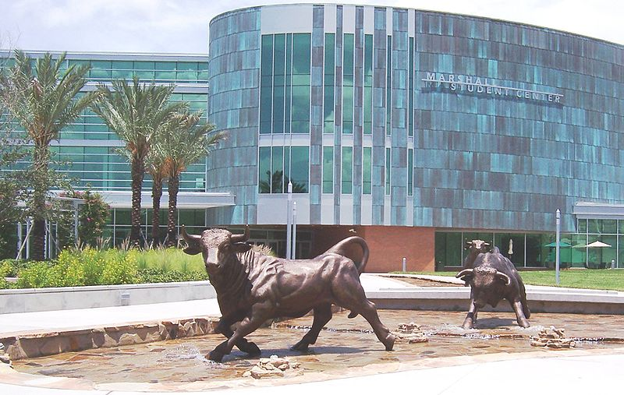
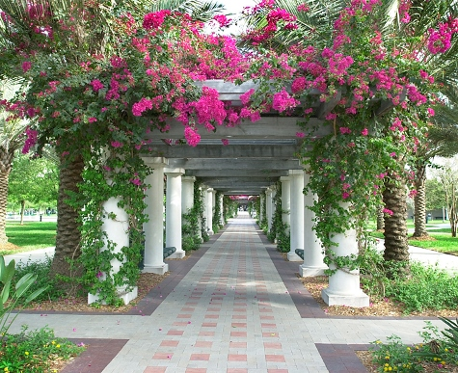
About USF
University of South Florida (USF):
Public, multi-campus, PhD-granting, high activity, research university
Main/largest = USF-Tampa, 42,000 students.

Slide 3
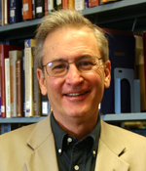
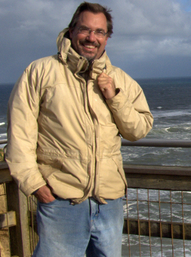
Computational Geology
Started S96. Upper level for geology majors.
Evolved from spreadsheets to solve calculus-based problems to current combination of problem sets, spreadsheets, and hands-on activities to solve geological-mathematical non-calculus word problems.
Taught by H.L. (Len) Vacher 1996-present and Charles B. (Chuck) Connor 2015-present. (VR as TA for both since fall 2015.)
Vacher, H.L. 2000. "A course in geological-mathematical problem solving." Journal of Geoscience Education 48 (4):478-481.

Slide 4
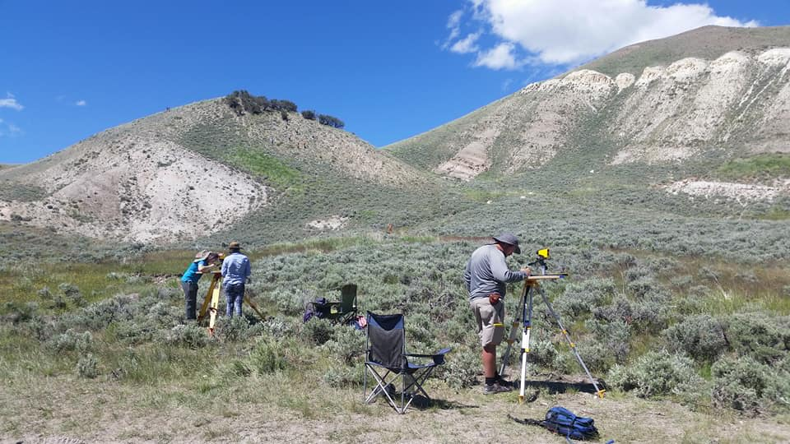
Scenarios
Different course from different instructors. Same frame, slightly different aims.
LV: nearly retired hydrogeologist/physical/geo for engineers. Heavy on math and biases toward “Computational Geology” columns from JGE.
CC: physical volcanologist/risk assessment expert. Prep for volcanology field mapping camp.
Next rumored instructor is planetary geochemist. Would teach… how?
JGE Computational Geology Columns at NAGT: https://nagt.org/nagt/jge/columns/compgeo.html

Slide 5
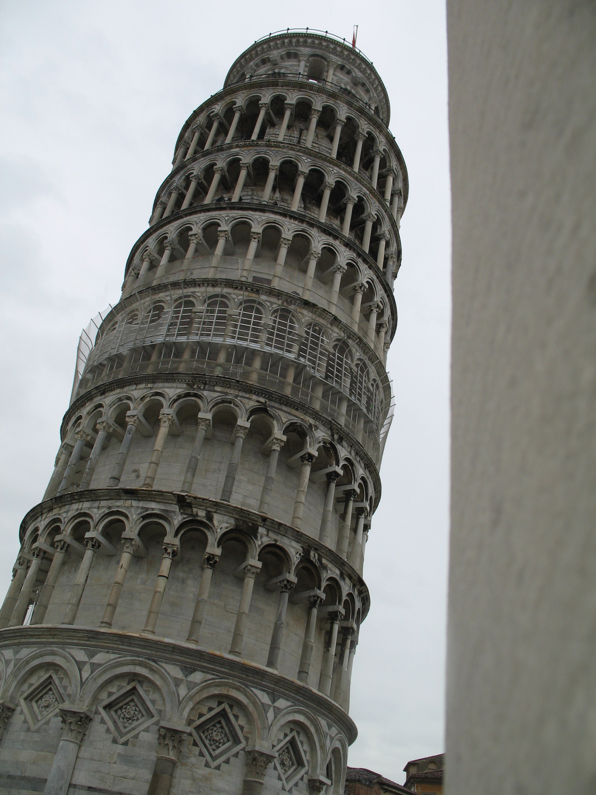
What the Course Aims to Do
When is the time to make mathematical mistakes?
School?
When someone’s budget, bridge, or drinking water depends on you?
Course aim: quantitatively literate geology majors. Prepared to be the geologist on professional scene, in unknown occupation.
  Solve problems using math skills
  Communicate with and about math, numbers, and units

Slide 6

Impediments to Computational Geology
Problems with implementing what we want students to be able to do:
Math anxiety/affective concerns
“They should already know this”
“Geology isn’t a math-type science” (GRRRRRRRRR)
By Katharine Moriarty - You scared me!, CC BY 2.0,
https://commons.wikimedia.org/w/index.php?curid=10738024

Slide 7
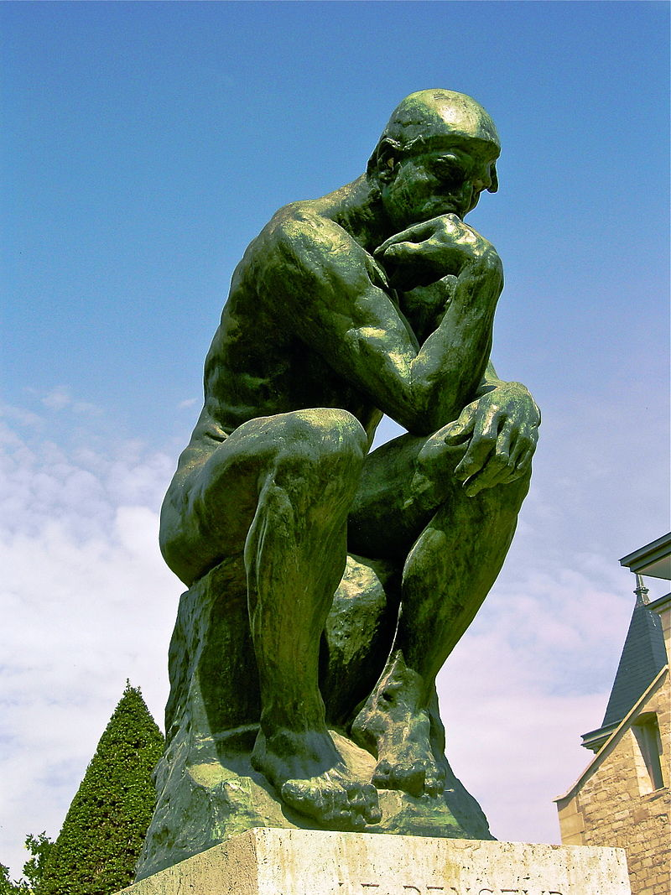
What we Think the Course Does
Gives students skills with problem solving, Excel, and numerical communication.
Changes the way students think. (It’s a thinking course.)
Years later they retain habits of mind, even if they lose some skills.

Slide 8
How we Know it Works
A sample of studies completed and in progress:
Alumni Narratives on Computational Geology (S97-F13)
  A Twenty-Year Look at Computational Geology, an Evolving, In-Discipline Course in Quantitative Literacy at the University of South Florida
Computational Geology in the Affective Domain
Geoscientist Quantitative Preparation Survey (in planning)
Photo by Cailin Hyuck Orr of CG demo

Slide 9
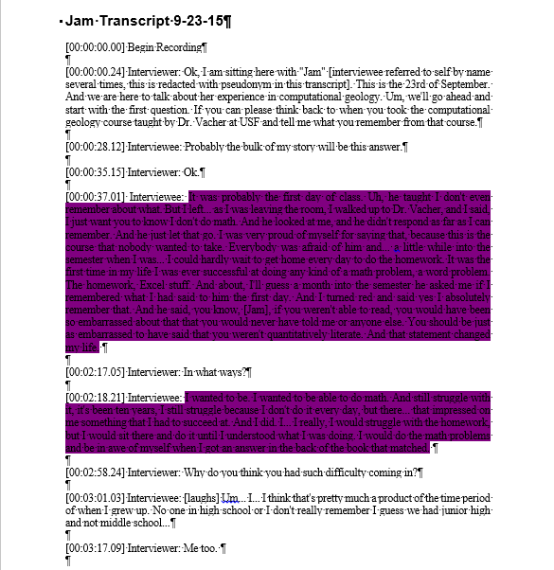
Alumni Narratives on Computational Geology (Spring 1997 - Fall 2013)
Interviews with 10 course alumni from 97-13 now in public, private, academic sectors.
Interviewees discussed memories, course uses, and suggestions.
NOT random and biased by nature, but for this group, course was highly instrumental in their development.
Ricchezza, Victor J. 2016. "Alumni Narratives on Computational Geology (Spring 1997-Fall 2013)." Master of Science Thesis, School of Geosciences, University of South Florida, Graduate Theses and Dissertations.
Ricchezza, Victor J., and H.L. Vacher. 2017. "A Twenty-Year Look at “Computational Geology,” an Evolving, In-Discipline Course in Quantitative Literacy at the University of South Florida." Numeracy 10 (1). doi: http://dx.doi.org/10.5038/1936-4660.10.1.6.

Slide 10
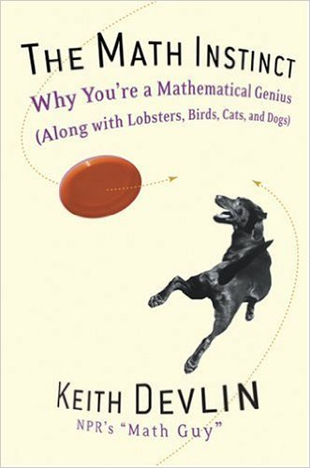
Computational Geology in the Affective Domain: Students’ Reaction to Devlin’s The Math Instinct
Interviewees from “Alumni Narratives” suggested more writing in CG. So...
  Intro statement about experience with math
  Chapter responses to Devlin’s The Math Instinct
  Final response on book and changes to attitude
Promising results: most students showed improved math attitude.
Ricchezza, Victor J., and H.L. Vacher. 2017. "Quantitative Literacy in the Affective Domain: Computational Geology Students’ Reactions to Devlin’s The Math Instinct." Numeracy 10 (2):11.

Slide 11
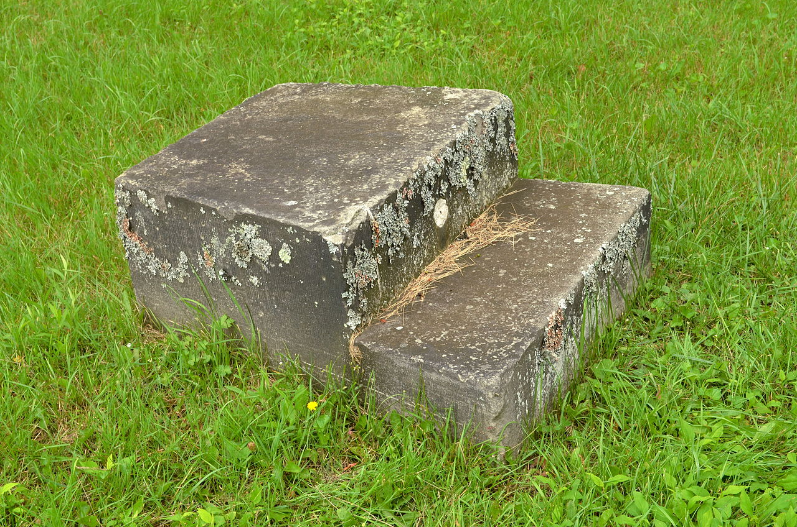
Geoscientist Quantitative Preparation Survey (The Next Step)
What next?
All the work so far is qualitative or not representative. We will be implementing a national survey of geologists (3-10 years after BA/BS graduation) on their quantitative preparation for the job(s) they perform.
Comparison of USF to national and regional trends.
By Niagara - Own work, CC BY-SA 3.0, https://commons.wikimedia.org/w/index.php?curid=28363710

Slide 12

Questions?

