Slide 1
Alumni Narratives on Computational Geology (Spring 1997 – Fall 2013)
MS Thesis
Victor J. Ricchezza
June 8, 2016
Committee:
Dr. H.L. (Len) Vacher – Co-Major Professor
Dr. Jeffrey G. Ryan – Co-Major Professor
Dr. Jeffrey R. Raker

Slide 2
Quantitative Literacy
QL – Quantitative literacy. The ability to use, manipulate, and communicate numbers and quantities as needed in a specific field, or in life.
Although it uses math, it isn’t the same thing. More thinking/problem solving/communicating than process.
“It wasn’t a math class” – John Smith

Slide 3
Needs of the Geoscience Field
The Summit on the Future of Undergraduate Geoscience Education (2014) discussed needs in UG GeoEd, then surveyed 455 professionals with similar results.
Relevant skills/competencies identified:
Problem solving/critical thinking
Effective communication
Strong quantitative skills and ability to apply them
Strong computational skills, ability to use large datasets

Slide 4
Needs of the Geoscience Field
Source: Summit on the Future of Undergraduate Geoscience Education (2014-15) http://www.jsg.utexas.edu/events/files/Survey_NSF_report.pdf

Slide 5
Computational Geology
Capstone course taught by LV for 20 years; started by student demand, then required after faculty assessment of needs (quantitatively literate geology graduates).
Infuses QL into geology to solve problems. (Vacher 2000)
Requires calculus 1 as prereq but isn’t calculus based course.
Does it achieve outcome? How?

Slide 6
Long Term Project
Qualitative study introduces work – this study
Wider mixed methods work – dissertation – to confirm and expand on the findings here.
Results of all studies to be applied to improve the course and disseminate to more campuses.

Slide 7
Thesis/Research Questions
What do alumni who took the course remember 3-20 years later?
What do they use from the course?
What would they recommend that students need to learn to be successful professionally?

Slide 8
Methods
Eligibility:
USF Geology graduate (BS level)
Took and passed course
Professionally successful (subjective – LV opinion only)
Represent public/private/academic sectors collectively
Identified pool of candidates (20) for contact using approved email script
Semi-structured interviews (10)

Slide 9
Methods
Narrative Inquiry Framework
Three structured questions:
What do you remember from CG course?
What from course did you use professionally or personally?
What would you like to see students learning in course that would help them succeed professionally after graduation?
Follow-up questions permitted.

Slide 10
IRB e22615
Informed consent on file (lock and key in my office). Participants not compensated.
Pseudonyms only (they chose). Minimal risk (reprisal).
Audio recordings made for transcription, then erased after transcript editing complete.
Expedited IRB approval e22615.

Slide 11
Interviewees
Regulators (SWFWMD)
Luke (MS)
Gilda (PSM in progress)
Sam (PSM in progress)
Consultants (various)
John Doe (PSM)
John Smith (PSM)
Medusa (MS, PG, part-time instructor, former regulator)

Slide 12
Interviewees
Academics
Jam (MS, full time instructor)
Arya (MS, PhD in progress)
Lee (MS/PhD in progress out of state)
Sunshine (MS, PhD in progress, instructor elsewhere, regulatory experience)
You probably know some of them, and may figure out which, but I must protect their anonymity – please respect this.

Slide 13
Results
Results have been categorized into four content areas:
Course structure evolution
Memories of class
Uses of class knowledge
Suggestions for class

Slide 14
Timeline
Medusa – Spring 1997
Jam – Fall 2001
Sunshine – ~Fall 2005
Gilda – Fall 2008
Luke – Fall 2009
Arya – Fall 2010
John Smith – ~Fall 2011
Sam – ~Fall 2011
John Doe – ~Fall 2012
Lee – Fall 2013

Slide 15
Course Structure Evolution

Slide 16
Medusa and Flexible Syllabus
“…he walked in and said ‘what’s holding you up? What sort of concepts are you having trouble with? What’s not working for you? Why are you failing calculus? What’s holding you up?’ And we spent the first couple of classes talking about that – what we felt we did and didn’t understand, you know… things for which we didn’t understand the relevance of why they were being presented to us. And he came up with a course description based on that.”

Slide 17
Common Course Experiences

Slide 18
Jam and Innumeracy
“It was probably the first day of class. Uh, he taught about I don’t even remember about what. But I left… as I was leaving the room, I walked up to Dr. Vacher, and I said, ‘I just want you to know I don’t do math’. And he looked at me, and he didn’t respond as far as I can remember. And he just let that go. I was very proud of myself for saying that, because this is the course that nobody wanted to take. Everybody was afraid of him and… a little while into the semester when I was… I could hardly wait to get home every day to do the homework. It was the first time in my life I was ever successful at doing any kind of a math problem, a word problem. The homework, Excel stuff. And about, I’ll guess a month into the semester, he asked me if I remembered what I had said to him the first day. And I turned red and said ‘yes, I absolutely remember that’. And he said, ‘You know, [Jam], if you weren’t able to read, you would have been so embarrassed about that that you would never have told me or anyone else. You should be just as embarrassed to have said you weren’t quantitatively literate.’ And that statement changed my life.”

Slide 19
Common Course Uses (condensed)

Slide 20
Sunshine and the New Car
“Well, ever since that course, I have used Excel. I never really used Excel before it, and I love Excel now. I use it for everything. I used it for my chemical data that I collected for my rocks for my master’s. I used it to create my budget for my house for, you know, my husband. I used an Excel spreadsheet to show my husband that we needed to trade in our other car and buy a new car because it was going to be gas efficient and we were going to save money. (…) And when I did the Excel spreadsheet for convincing my husband to buy a car, I had… I made the spreadsheet up and I had the, um, the amount of what gas would cost as a variable, the amount of miles he was traveling, um, what different types of gas… miles per gallon for each car we were thinking about buying. Then comparing that to what we were spending right now with the car that he was driving, so looking at gas and tolls and then comparing that to how much it would cost… how much it would save us if we bought a new car that was gas efficient, but we had a car payment, but the car payment was still, the car payment plus the gas was still lower than having a car that was already paid off but horrible gas mileage. And I made a whole spreadsheet that he manipulated and played with all these different variables and it changed the bottom number to figure out how much we would save every month. And that convinced him and we went and bought a new car.”

Slide 21
Common Suggestions for Class

Slide 22
Negative Comments
Few common issues, so nothing in tables.
Sunshine stated that geology is outside, but class is inside.
Arya discussed student abuse of generous attendance policy related to H1N1 outbreak.
Lee mentioned students getting a lot of help from the TA, not working for themselves.
Jam mentioned several stories of aggravation with LV’s methods.

Slide 23
Analysis
Coding – relevant words/phrases/etc. highlighted to be counted or compared.
Constant comparative method (Glaser 1965), combination of standard coding with visual analysis during coding.
Grounded theory (no pre-set codes, based on data).
Used two colors to code – yellow for common statements or codes, purple for unique.
Regulators almost all yellow, academics heavy purple, consultants mixed.

Slide 24
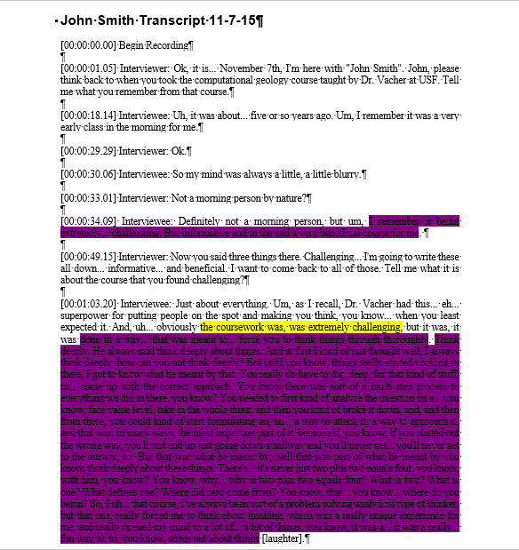
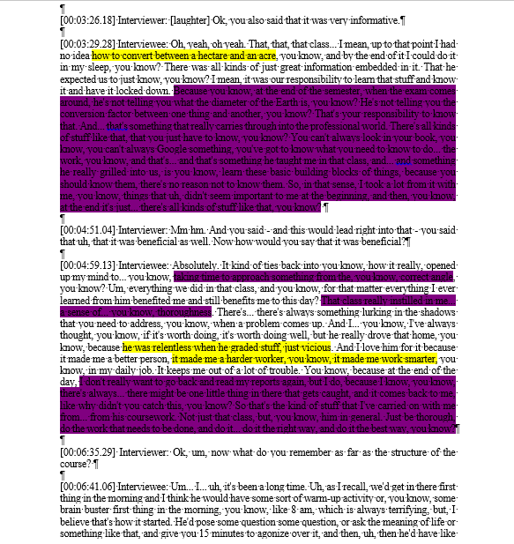
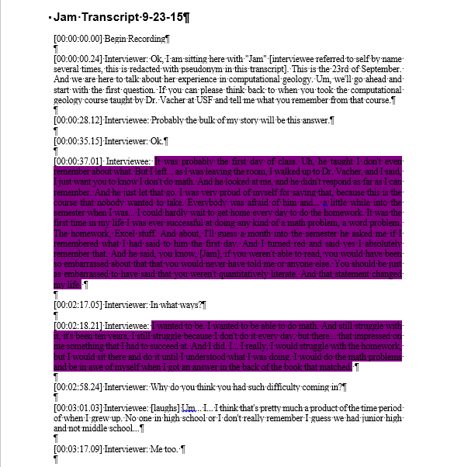
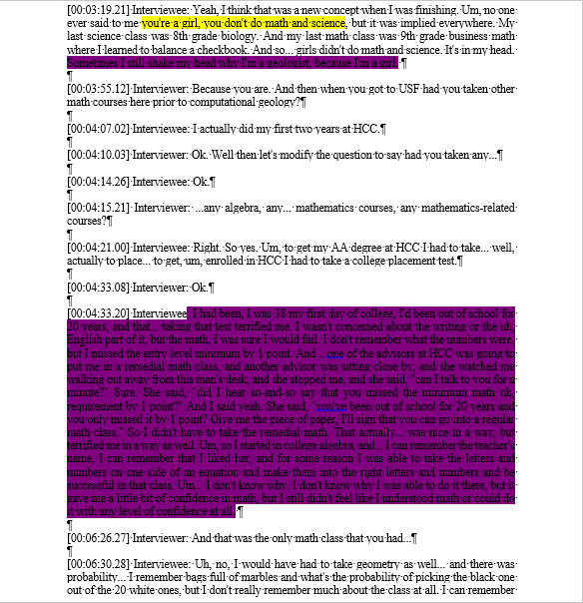
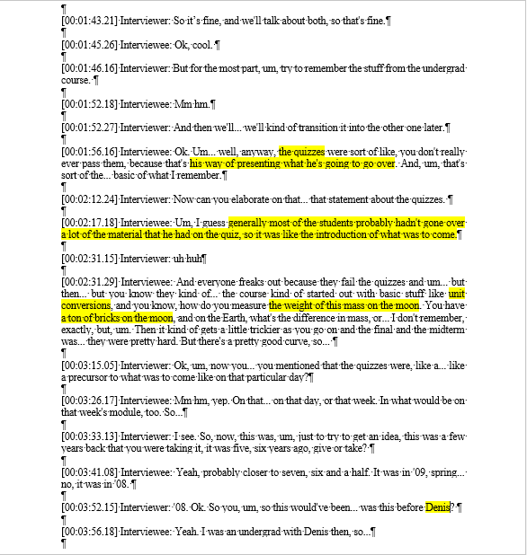
Analysis – first 2 pages of samples
Academic
Consultant
Regulator

Slide 25
Analysis
Overall avg. 36.7 minutes (Gilda 19:53 – Jam 56:51)
Regulator avg. 23.7 minutes (19:53-31:06)
Consultant avg. 33.9 minutes (25:17-39:40)
Academic avg. 48.6 minutes (43:40-56:51)
Why the difference?

Slide 26
Why are career groups different?
Regulators had much harder time remembering specific details of the course, or uses of the course beyond Excel and unit conversions.
Do regulators, consultants, and academics use QL differently in their job?
Analysis indicates a strong YES, but doesn’t give a why. (I have ideas from experience, but no science to back them.)

Slide 27
Outcomes
Norris, Phillips, and Burns (2014) classed learning into knowledge/capacities/traits.
Independently, LV classed knowledge as facts/concepts/skills. Skills in this context assumed to overlap with capacities.
To show QL among interviewees, specific quotes were found for each person.
Quotes found from all interviewees, selection follows.

Slide 28
Knowledge/Facts
“He’s not telling you the conversion factor between one thing and another… that’s your responsibility to know. And that’s something that really carries through into the professional world.” – John Smith
“I think I have probably used every single Excel function Dr. Vacher showed us.” – Gilda

Slide 29
Knowledge/Concepts
“A derivative is change over time, that’s all it is. Geology is change over time. Almost everything we look at in geology is change over time.” – Medusa
“That was his entire course, was just learning how to think things through logically in a step by step manner.” – Lee

Slide 30
Skills/Capacities
“I learned a lot about Excel… I can look through a sheet and reverse engineer it, find out the calculations… that people have submitted to me.” – Luke
“Converting, you know, from different units and that sort of thing.” – Sam

Slide 31
Traits
“I want my students to be quantitatively literate.” – Jam
“I’ve become a more analytical person because of it.” – John Smith
“He made it a tool I can use, and made it something I wasn’t afraid to use, and made it something I was excited to use and felt empowered to use instead of somewhat fearful of.” – Medusa

Slide 32
Reflexivity (Limitations)
Bias!
Selection bias – only successful alumni chosen. Not random or representative.
Convenience sampling – no travel funds.
Confirmation bias: Leading questions avoided (thanks Jeff Raker!) in protocol but some in follow up questions (not quoted)
Everyone beholden to Len, including me!
My interests also tied in with class success.
Sample not intended to be representative! To be used to help with questions for survey.

Slide 33
Conclusions
Reactions to class overwhelmingly positive.
However, due to selection bias… does that mean anything for most students? More information needed!
Useful and concrete course for geologists in variety of career paths.
Helpful suggestions obtained for course improvement.
Survey question generated! (List too tentative to share, revision in progress.)

Slide 34
What Next?
Changes to the course are in progress, some of which match suggestions given; more to follow.
Dissertation – show quantitatively whether/how this course meets the needs of the field:
Develop and use assessment instrument for QL-in-geology to find the effectiveness of course improvements. Useful beyond this course.
Online survey to broader population of alumni based on results of interviews and existing literature.

Slide 35
About that index card
Take a moment through the Q&A to think about what geoscience education research questions this study made you want to know the answers to. Please write your question(s) on the card.

Slide 36
Acknowledgements
Lis, Christine, Kaydee, Matt, Jacob, Denis, Anita, and Kelli
Len, for the equipment and software
F15/S16 CG Students
Interviewees
Shannon Ricchezza

Slide 37
Questions?

Slide 38
Module Example (Crater Lake)

Slide 39
What would unsuccessful say?
Professionally unsuccessful?
I picked the wrong job.
This class/program didn’t speak to my strengths.
I didn’t work hard enough/pay enough attention.
Academically unsuccessful?
I didn’t understand this/it was too hard.
I didn’t try hard enough.
I picked the wrong major.
I’m scared of math.

Slide 40
So, what good is it?

Slide 41
So, what good is it?
Narrative inquiry tells people’s stories in greater detail than a survey.
Long form interviews allow me to frame future survey questions.
We aren’t just here to be geologists, we’re here to train geologists. This study let us ask some of them what it’s like to be one in a variety of jobs.

Slide 42
DBER
With heavy emphasis on publishing papers and funding grants, teaching suffers, despite lip service claims of its importance.
Solution: Discipline-Based Educational Research (DBER). Research, within a specific field, by experts on that field, on how best to educate undergraduate students.
GER – Geoscience Education Research. My research is learning how undergrads learn geology, so we produce better geologists.

Slide 43
Common Experiences – Napkin Math
“I remember doing math on a piece of napkin that was Dr. Vacher’s goal for the class. That if you could sit in an airplane next to somebody and explain a math problem… on… a regular cocktail napkin, and you could draw a little diagram, that you were successful in his class.” – Sunshine
Also as “back of the envelope math”

Slide 44
John Smith – Thinking
“[The course] was meant to… force you to think things through thoroughly. Think deeply. He always said think deeply about things. And at first I kind of just thought well, I always think deeply, how can you not think deeply? But until, you know, things really started cooking in there, I got to know what he meant by that. You really do have to dig, deep, for that kind of stuff, to… come up with the correct approach. You know there was sort of a multi-step process to everything we did in there, you know? You needed to first analyze the question on a… you know, face value level, take in the whole thing, and then you kind of broke it down, and, and then from there, you could kind of start formulating… a way to attack it, a way to approach it, and that was, in many ways, the most important part of it, because if, you know, if you started out the wrong way, you’ll just end up going down a hallway and you’ll never get out… you’ll never get to the right answer.” – John Smith

Slide 45
Sunshine and the FRB
“I became really good friends with, um, some ladies, uh, in the course… which we call ourselves “The Front Row Bitches”… So if anybody has met Vacher… he can seem very unapproachable at first, and not relatable… so there’s four of us. Four Front Row Bitches. We… did not succumb to Dr. Vacher’s intimidating aura, so we sat in the very front row. All four of us in the front row. Everybody else sat back behind us pretty far back. We wanted to learn. We wanted to hear what he had to say, and the only way to… truly be successful in his course was to be involved and to be… connected to Dr. Vacher, to be able to stop him whenever you have a question or be able to… ask him to elaborate… So we sat in the front row and we asked him questions all the time… he was not used to that. (…) And all four of us are still very good friends.”

Slide 46
Sunshine and Math Avoidance
“I can now say being, you know, an educator and a, um, a person who studies how people learn and specifically looking at math avoidance that I did avoid math and I still do. I’m trying to overcome that as I’m sure lots of people are. So… for me to take that course, which it was a requirement for a geology, um, BS, I knew that I had to take a (sic) assertiveness in my own education and sit up front and be there or I was not going to succeed. I just knew that personally because of how I am, so. And that’s how the other four girls, the other three girls were as well. You know, we just knew that’s what we wanted to do. We wanted to pass this course.”

Slide 47
Jam and the Meaning of Calculus
“Somebody says the word logarithm and I say, yeah, man, he made it so clear. (…) And I’ve said this to him, I’ve said it to current and former students in his class, and I’ve said it to people outside of USF. I really felt like I learned more in a ten minute discussion in his class about calculus than I learned in two semesters sitting in calculus math class here at USF. (…) At the end of those two semesters [of engineering calculus 1 and 2], I didn’t know why you do calculus. I never got that a derivative was the slope of a line and that the integral was the area under the slope. Two semesters, I never got that. I… I learned how to take letters and numbers here, and then there was the equal sign, and I had learned how to change those same letters and numbers and make them different over here. And I could do it. I think I got an A or A- in calculus, which I was like, how did I do that? I didn’t understand it at the end. And in ten minutes, when he explained this is why… this is what a derivative, all it is is the slope of a line… oh, the light came on. (…) And… you don’t hear that in a math class. At least if you do, I wasn’t paying attention that day. The same… if they ever said a derivative is the slope of a line? I completely missed that.”

Slide 48
Medusa Loses Her Fear
“The course… allowed me to see mathematics as a tool that I can realistically use in the applications of geoscience instead of viewing calculus etcetera as a separate thing from geology. Um, and it took the fear away. It was a very common theme at the time, um, that, you know, folks felt challenged by a lot of the math courses that they were in. They were having trouble with them. Some of them were even failing them. When these concepts really are quite central to geology. And Len saw them as central, didn’t understand why we weren’t, you know, functioning within both equally well, um, so he look at how those courses are being taught, and how geologists think, and created a course that took the fear out of math, which is huge.”

Slide 49
Medusa’s Primary Questions
“Well, he answered what I call the primary questions. Which actually may be a concept I got from Len, I don’t remember where I got it, it very well could have been Len. Primary questions being “so what?” and “who cares?” So, um, he went back to relating to the concepts that geologists work with every day. You know, a derivative is change over time, that’s all it is. Geology is change over time. Almost everything we look at in geology is change over time. Until he said that to me, in that sentence, I had never seen it, I had not seen a derivative that way, and I had not really applied, oh, that’s why I might want to use that in geology. Why this, the… the mathematics and the computations are so inherent in the application of geoscience. Um, and so he firstly made it relevant for us, and secondly, was able to get to the nuts and bolts of how you use it instead of just fluttering about with the theory that a lot of the courses were doing. You know, um, a… this is more physics than calculus, etcetera, but you know, a ball’s coming at you at a certain angle, and if somebody hits the ball, how’s it going to go? Well, you know, in my mind, the answer to that was ‘home run’. You know, I didn’t… the nitty gritty of that didn’t matter to me, and Len was able, um, to help me understand exactly why I would want to know that. And why I would want to use these tools to get there. So it… he… he… made it a tool that I can use, and made it something I wasn’t afraid to use, and made it something I was excited to use and felt empowered by instead of somewhat fearful of.”

Slide 50
Unique Uses – John Doe
“I think, um, what the course did was make us wary of statements like “greater than” or “percent more”. Um, Dr. Vacher has a very, um, strict policy on using certain phrases to describe something, um, so description of percent more should mean, you know, percent more than and that was actually a small segment of his course, so I think what it made us, what it makes me do is when someone says something like that or a statistical phrase, um, I think about it and say, “is that what they really mean”, because I know mistakes are made all the time.”

Slide 51
John Smith and Quantitative Literacy
“It [QL] sort of pervades… everything, you know? So it has impacted my personal life, for the better, of course, but things like that, you know? I’ll go into the store, I’m trying to, you know, get a deal on lemons, you know, I’m looking at it, and I’ll go, what’s the price per ounce here? You know, should I get the big lemons or the small lemons? You know, get the bag of lemons or should I buy them individually, you know? And it… the wheels start turning automatically now, you know, whereas I used to just, oh, $2, $1, I’ll get the $1 bag, you know? But it’s stuff like that happens all the time. All the time. You’ve got to think ahead, and you know, just analyze things. I’ve become a more analytical person because of it, you know?”

Slide 52
Outcomes
Knowledge/Capacities/Traits

Slide 53
Outcomes

Slide 54
Outline
Background and Introduction
Methods/IRB
Results
Analysis
Outcomes
Reflexivity (Limitations)
Conclusions/Next Steps
Questions

