Slide 1



Word Problems Across the Curriculum: Lessons Learned from Computational Geology at the University of South Florida
Victor J. Ricchezza
H.L. Vacher
Charles B. Connor
A copy of this presentation can be found at:
https://vicricchezza.weebly.com/publications
Or write to ricchezza@mail.usf.edu or scan the QR code

Slide 2
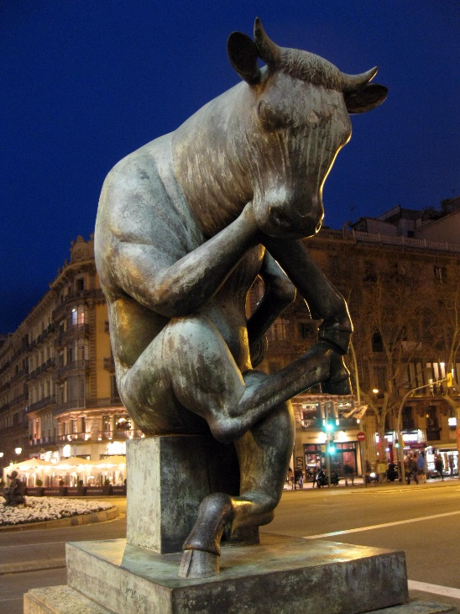
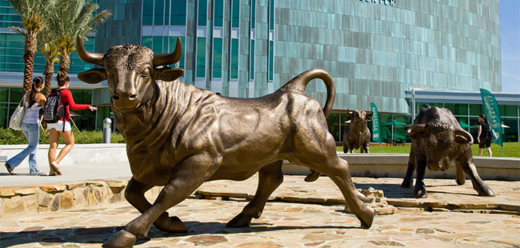
Why Are We Here?
CG taught by Len since ‘96
Instructors and TAs have learned a little
Word problems now primary delivery method; seem to work best for QL/QR/Numeracy in geology
How does this intersect with what you do?
Cross-disciplinary work is the best of education when it isn’t administrative lip service
El Toro Assegut by Josep Granyer,
Barcelona; Photo by Enfo - Own work,
CC BY-SA 3.0 es,
https://commons.wikimedia.org/w/index.php?curid=25887468
Bulls statue and fountain at Marshall Student Center, USF Tampa campus, photo taken from http://www.floridatrend.com/article/21759/usf-graduate-program-ranked-no-2-in-the-nation-by-us-news-and-world-report

Slide 3
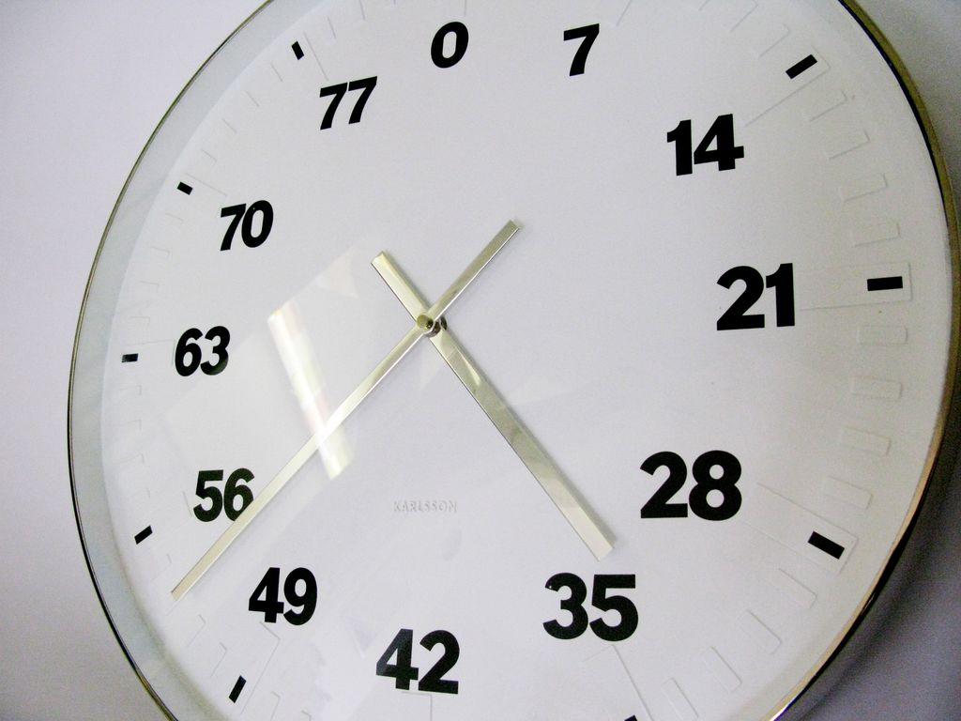
Facilitated Session Introduction
(How we Will Fill the Hour)
Primer questions and thoughts
History of Computational Geology (CG)
Summary of studies and learnings from CG
Mini-interview with Len Vacher on CG
Audience questions for Len (or me, I suppose)
Open discussion
Summary and takeaways
A copy of this presentation will be available on Vic’s website at https://vicricchezza.weebly.com/publications/
“Life Clock” by Bertrand Planes. Photo by Neologico - own work, CC BY-SA 3.0, https://commons.wikimedia.org/w/index.php?curid=19295880

Slide 4
Primer Questions and Thoughts
We ask you to think about these questions before we move on:
  What sort of attitudes do students have about math when they enter your classroom/discipline?
  How have traditional math educational/curricular approaches helped or harmed these students before they reached you?
  What do you want students to actually do with your QL course – what skills and/or habits of mind are important to you and your discipline for long term retention?
  How (if at all) can the methods that seem to be successful at the intersection of QL and geoscience be adapted to other disciplines?
And now, let’s talk about the history of Computational Geology…

Slide 5
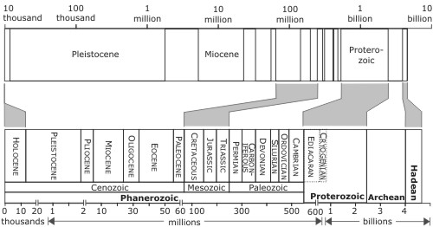
But before the history lesson…
Logarithmic scale of geologic time, taken from “Highly Allochthonous” by Chris Rowan, http://all-geo.org/highlyallochthonous/2008/08/more-thoughts-on-illustrating-geological-time/

Slide 6
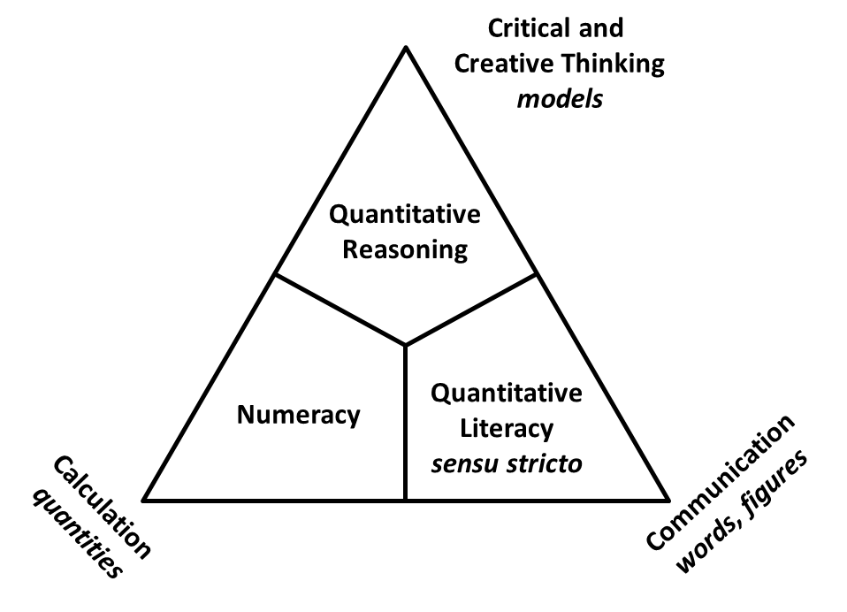
What is Computational Geology About?
Quantitative Literacy sensu lato
Goals and Methods
Learn how to solve problems!
From day one, How to Solve It has been essential. (Polya 1945)
Four step process for problem solving:
  Recognize the problem
  Establish a plan
  Carry out the plan
  Look back

Slide 7
Computational Geology
Successor to graduate course “Math Concepts for Geologists”
MCfG due to inadequacies of graduate students
CG started 1996 by student petition
Originally spreadsheets and calculus-heavy
Now focused on sets of word problems supported by spreadsheets and hands-on activities/labs
  LV discussed at length in MAA interview with Gizem Karaali
  (upcoming book, Tunstall, L., Karaali, G., Piercey, V., Shifting Contexts, Stable Core: Advancing Quantitative Literacy in Higher Education, an edited volume of articles, manuscript under consideration, expected publish date 2018)
  Vacher, H.L. 2000. "A course in geological-mathematical problem solving." Journal of Geoscience Education 48 (4):478-481.
  Ricchezza, Victor J., and H.L. Vacher. 2017. "A Twenty-Year Look at “Computational Geology,” an Evolving, In-Discipline Course in Quantitative Literacy at the University of South Florida." Numeracy 10 (1). doi: http://dx.doi.org/10.5038/1936-4660.10.1.6.

Slide 8
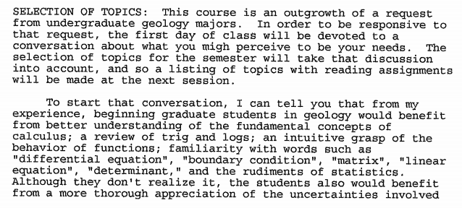
1997 Syllabus
This is a selection from the 1997 syllabus (the second offering)
Similar to the first offering
Topics based on student needs
Determined at first meeting
Heavy use of spreadsheets for problem solving

Slide 9
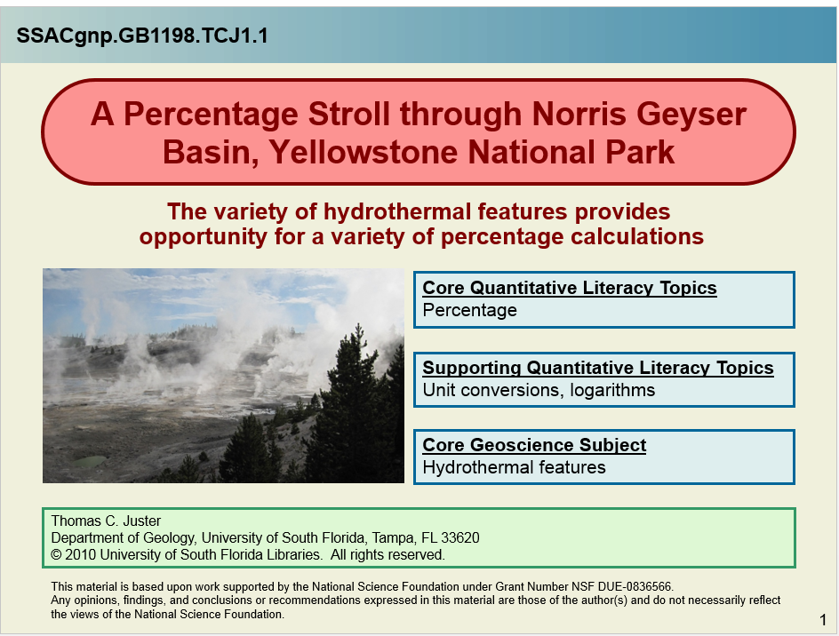
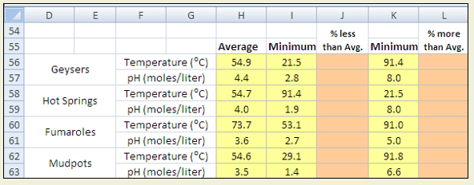
Spreadsheet Modules
Started around 2002
Three NSF grants for Spreadsheets Across the Curriculum.
Each has a PowerPoint with instructions and background.
Students complete guided Excel sheet for lab credit.
At one point they made their own for class projects.
4 SSAC papers in Numeracy.
https://serc.carleton.edu/sp/ssac_home/index.html

Slide 10
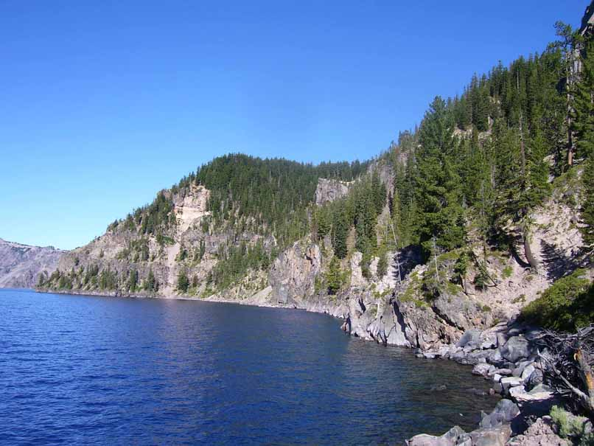
How Much Water is in Crater Lake?
SSACgnp.GB1601.HL1.1
Using prisms to calculate volume.
H. L. Lehto
Core Quantitative Literacy Topics
Contour Maps
Volume
Supporting Quantitative Literacy Topics
Unit Conversions
Estimation and Accuracy
Core Geoscience Subject
Bathymetric maps
Heather Lehto
Department of Geology, University of South Florida, Tampa, FL 33620
© 2009 University of South Florida Libraries. All rights reserved.
This material is based upon work supported by the National Science Foundation under Grant Number NSF DUE-0836566.
Any opinions, findings, and conclusions or recommendations expressed in this material are those of the author(s) and do not necessarily reflect the views of the National Science Foundation.

Slide 11
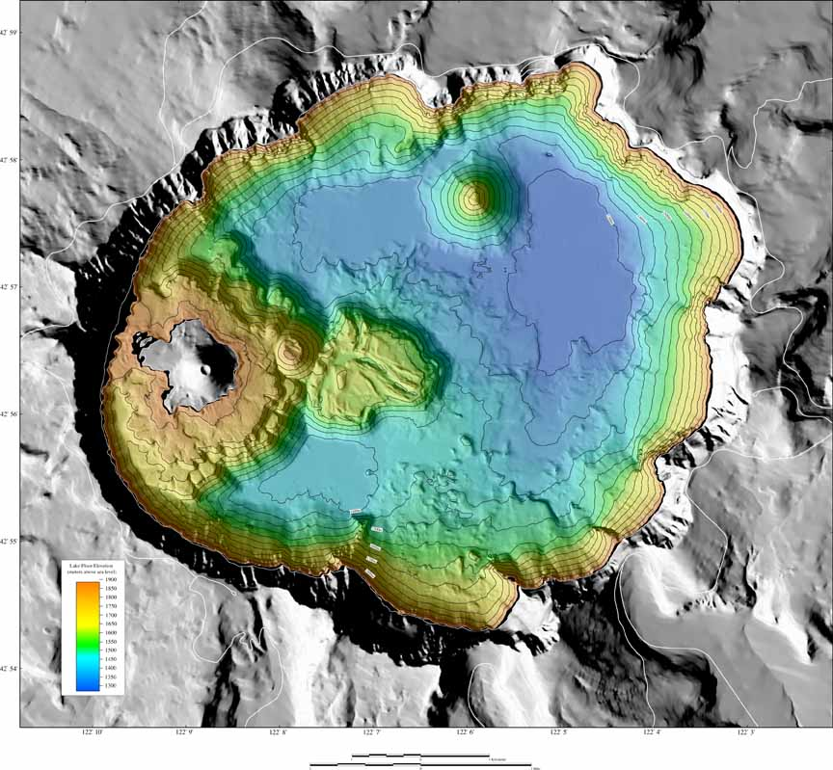
Bathymetry of Crater Lake
This bathymetric map of Crater Lake was created from data collected during a survey completed in the summer of 2000 by the USGS, NPS, and University of New Hampshire. The data were collected at a spatial resolution of 2 meters using sonar. For more information about this survey or to download the data see: http://geopubs.wr.usgs.gov/dds/dds-72/index.htm
A spatial resolution of 2 meters means that each elevation point represents a 2 m × 2 m square. This resolution provides much more data than is needed to calculate an accurate volume and much more data than Excel can handle, so the data have been re-sampled to much lower resolutions of 500 meters, and 2000 meters and are included in an Excel file included on the next slide.
Image from http://geopubs.wr.usgs.gov/dds/dds-72/site/mpvw.htm

Slide 12
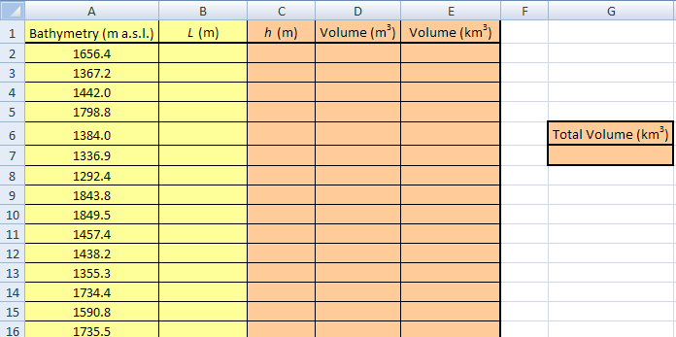
The spreadsheet (provided)
Click on the Excel worksheet to the right and save immediately to your computer. Complete the spreadsheets at each of the tabs starting with “2000 Grid.” Yellow cells contain given values, and orange cells contain formulas. The spreadsheet at the “EOM Answers” tab is for your answers to the end-of-module questions.
The Excel file contains two sheets, labeled 2000 m grid and 500 m grid. Each sheet contains five columns for each row of data (each row is a prism), and one column with only one cell:
Bathymetry (m a.s.l.): Elevation of lake bottom for a single prism,
L (m): length of sides of base of prism,
h (m): height of prism,
Volume (m³): volume of prism in meters cubed,
Volume (km³): volume of prism in cubic kilometers,
Total Volume (km³): total
volume of water in Crater Lake in cubic kilometers.

Slide 13
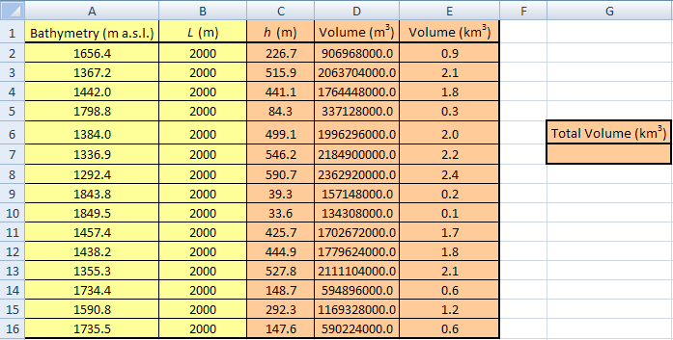
Conversions
The volumes you just calculated are very large numbers and not very easy to work with. To make them easier to compare you can convert them to km³.
Hint: Because the volumes are in m³ the conversion factor must also be cubed.
Your spreadsheet should now look like this one.

Slide 14
End-of-module assignment
Now that you know the most accurate volume of water in Crater Lake convert this volume into gallons. If the government decided to sell each gallon of water in the lake for $1, would they be able to pay off the national debt?
You just learned that the rectangular prism technique has sources of error that stem from the shape of the prism used. How might you design a new technique for calculating the volume of a complex shape such as Crater Lake? What 3D shape or mixture of shapes might you use to reduce the amount of error associated with “unfilled” volumes?
The volcanism that began to rebuild Crater Lake resulted in the formation of two smaller volcanic vents. One, called Wizard Island, rises above the lake surface while the other, Merriam Cone, remains hidden beneath the water. Using the spreadsheet attached below calculate the volume of Merriam Cone using an elevation of 1289 m a.s.l. as the base of the cone. The only difference between this calculation and the one you used in the module is that this time your volume is upside down so you will need to use the absolute value (ABS) function in Excel to calculate the height.
4. The estimated height of the summit of Mount Mazama is 3,700 m a.s.l. The diameter of the caldera rim of Crater Lake is 9.7 km and the elevation of the bottom of the lake is 1943 m a.s.l. Assuming that the lake bottom is flat (big assumption) use the above information to create a spreadsheet to calculate the volume of the former summit of Mount Mazama that was blown away during the cataclysmic eruption ~7,700 years ago (in km³). Hint: A cone is a reasonable approximation for the shape of the summit.
5. If Crater Lake were to begin erupting lava flows and rebuilding it’s summit at an eruption rate of 2.0 × 10⁻³ km³/year how many years would it take for the volcano to reach the same height (and therefore volume) that Mount Mazama was before the eruption ~7,700 years ago.

Slide 15
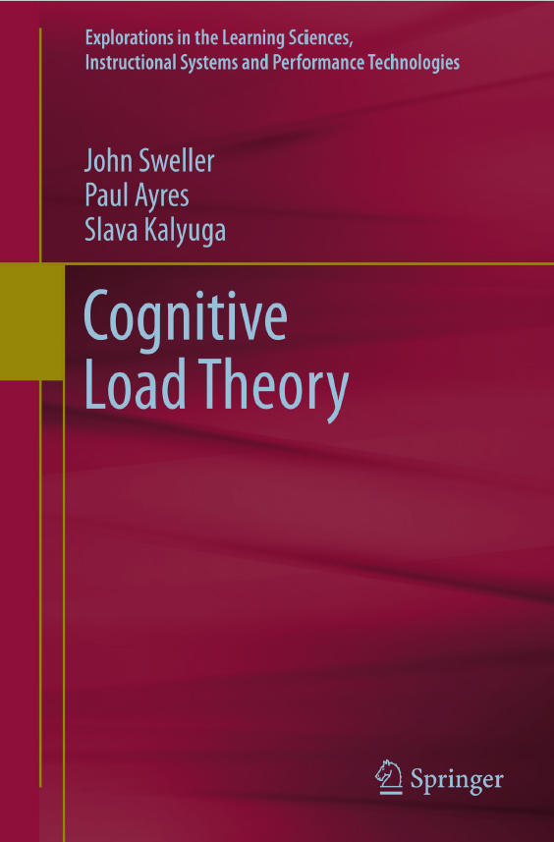
Cognitive Load Theory
Course redesigned in 2015
Based on Cognitive Load Theory (Sweller 1988, 2011)
Instructors are experts, students are novices
Novices use cognitive memory for unfamiliar tasks
Students weren’t getting enough practice before
Now students complete ten problem sets to get that practice
After first year, weekly quizzes added to incentivize work
Worked example versions of quizzes and sets released afterward

Slide 16
Word Problems and Problem Sets
Word problems did feature in the course before the problem sets via exams
Students in 2013-2016 also wrote their own word problems (now a lab)
Before reform, number of problems seen was insufficient to form mental schemas
Problem Sets
    PS 1 Numbers and Counting
    PS 2 Quantities and Units
    PS 3 Proportions and Percentages
    PS 4 Sums and Averages
    PS 5 Ratios and Rates
    PS 6 Estimation and Error
    PS 7 Circles and Angles
    PS 8 Logarithms and Log Scales
    PS 9 Lines and Planes
    PS 10 Modeling Functions

Slide 17
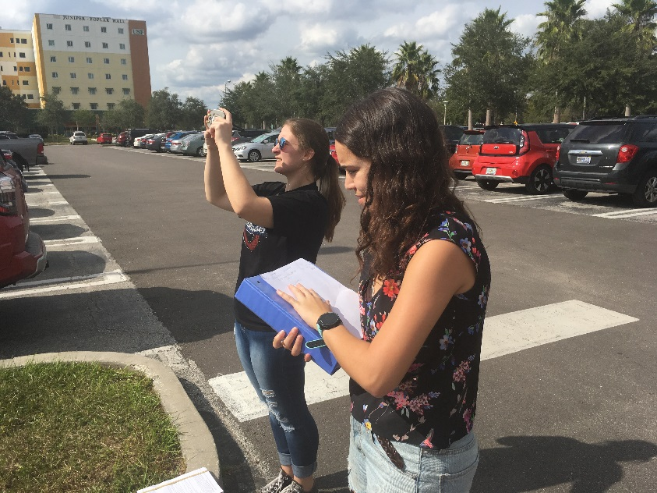
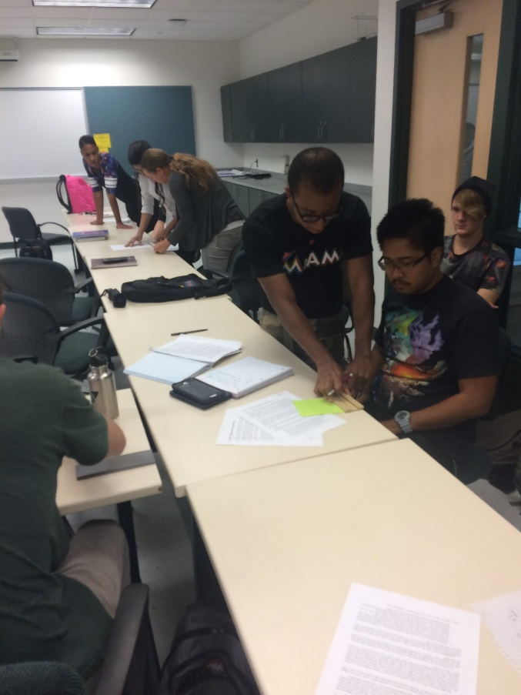
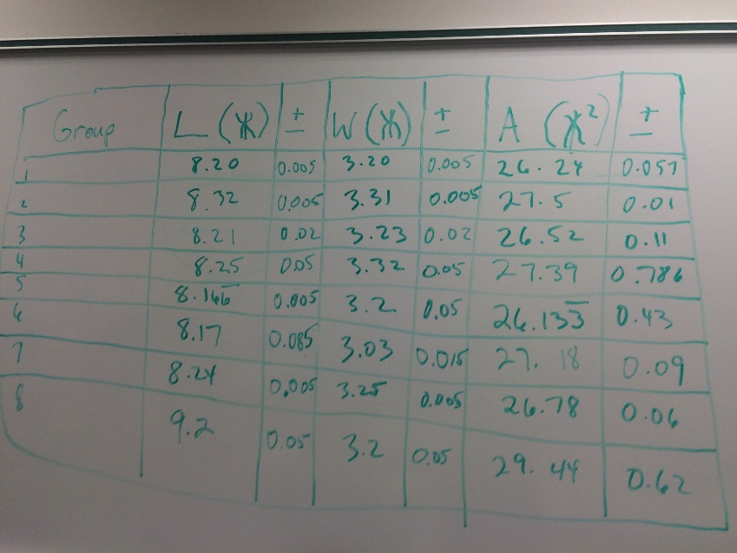
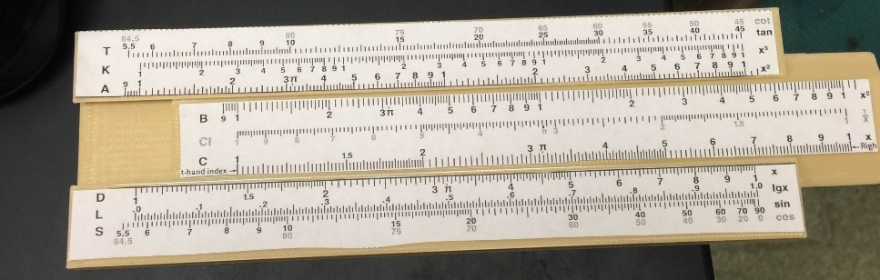
New Labs
Arithmetic and mental math
Measurement with a stick (Ricchezza and Vacher, 2016)
3D printed slide rules
Triangles in the wild (law of sines and Cramer’s rule)
Plotting “straight lines” on different graph papers
Top right photo by Cailin Hyuck Orr, Earth Educators Rendezvous, Madison, WI, 2016. All other photos by VR from CG.

Slide 18
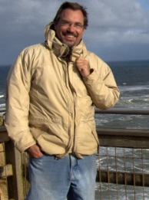
Second Instructor
To keep up with student demand, all core classes now offered twice annually
CG course added second instructor spring 2016
Charles “Chuck” B. Connor, physical volcanologist and risk assessment expert, teaches spring cohort
Chuck also teaches field camp sections in summer
Spring version takes same basic problem sets, converts focus to field readiness

Slide 19
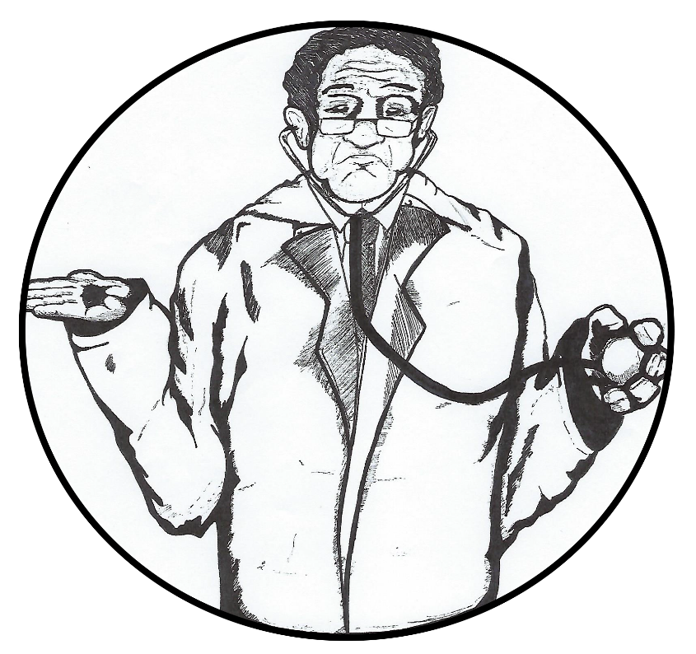
How Do We Know?
We’re making claims here. How do we know any of this is so?
Shrugging Doctor Brewing Company Logo, Photo
By VoteWillows - Own work, CC BY-SA 4.0,
https://commons.wikimedia.org/w/index.php?curid=49338409

Slide 20
Alumni Narratives on Computational Geology (Spring 1997 – Fall 2013)
Interviewed 10 CG alumni in 2015-6. Mix of public/private/academic.
Asked three questions, with follow-ups unscripted:
  What do you remember from CG?
  What do/did you use from CG?
  What should students be learning in CG for professional success?
Consistent responses: Excel and unit conversions prominent in responses to all three questions. Communications and big data sets also listed as very important.
Ricchezza, Victor J., "Alumni Narratives on Computational Geology (Spring 1997 – Fall 2013)" (2016). Graduate Theses and Dissertations.
http://scholarcommons.usf.edu/etd/6366
One suggestion was improved communication, so…

Slide 21
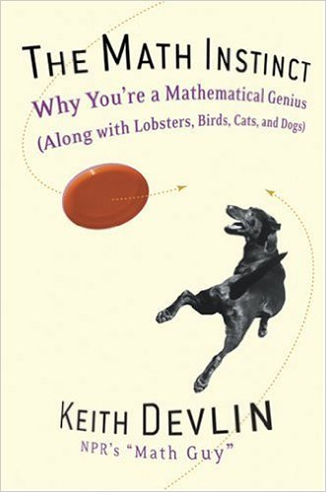
Quantitative Literacy in the Affective Domain: Computational Geology Students’ Reactions to Devlin’s The Math Instinct
Students gave intro statement on feelings/history about math
Students assigned to read The Math Instinct by Keith Devlin
Students gave weekly chapter responses (13)
Term ended with 1-2 page paper discussing what they got from book, any change in attitude
Significant “damaged” attitudes about math noted, much math anxiety at start
Notable improvement in student attitudes over the semester
Ricchezza, Victor J., and H. L. Vacher. "Quantitative Literacy in the Affective Domain: Computational Geology Students’ Reactions to Devlin’s The Math Instinct." Numeracy 10, Iss. 2 (2017): Article 11. DOI: http://doi.org/10.5038/1936-4660.10.2.11

Slide 22
A Morning Chat with Len Vacher

Slide 23
Some Questions for Len
I’ve given Len some questions ahead of time to think over, but I have no idea what his answers will be. I will ask follow-up questions. I also have a surprise question up my sleeve that he hasn’t seen.
Questions he’s seen:
  What do you know now that you didn’t know in 1996?
  What do you wish you had done differently with the CG course?
  If you had 20 more years to devote to teaching this course, where would you take it?

Slide 24
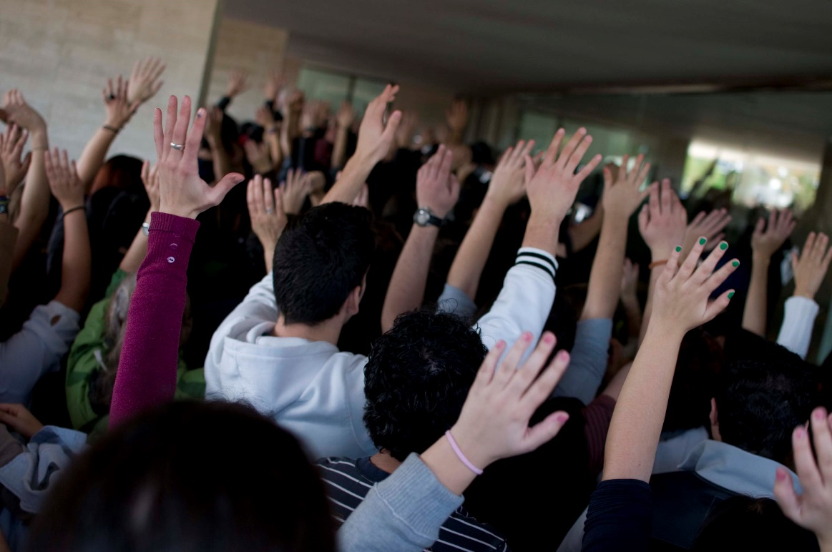
Audience Interaction
We want to talk to you now
By Izquierda Unida
La mañana de Valladolid en imágenesUploaded by ecemaml,
CC BY-SA 2.0, https://commons.wikimedia.org/w/index.php?curid=22697532

Slide 25
Remember These? Your Turn Now
Audience Participation Time
  What sort of attitudes do students have about math when they enter your classroom/discipline?
  How have traditional math educational/curricular approaches helped or harmed these students before they reached you?
  What do you want students to actually do with your QL course – what skills and/or habits of mind are important to you and your discipline for long term retention?
  How (if at all) can the methods that seem to be successful at the intersection of QL and geoscience be adapted to other disciplines?
  Did the discussion with Len (or the presentation) conjure up any new ones?

Slide 26
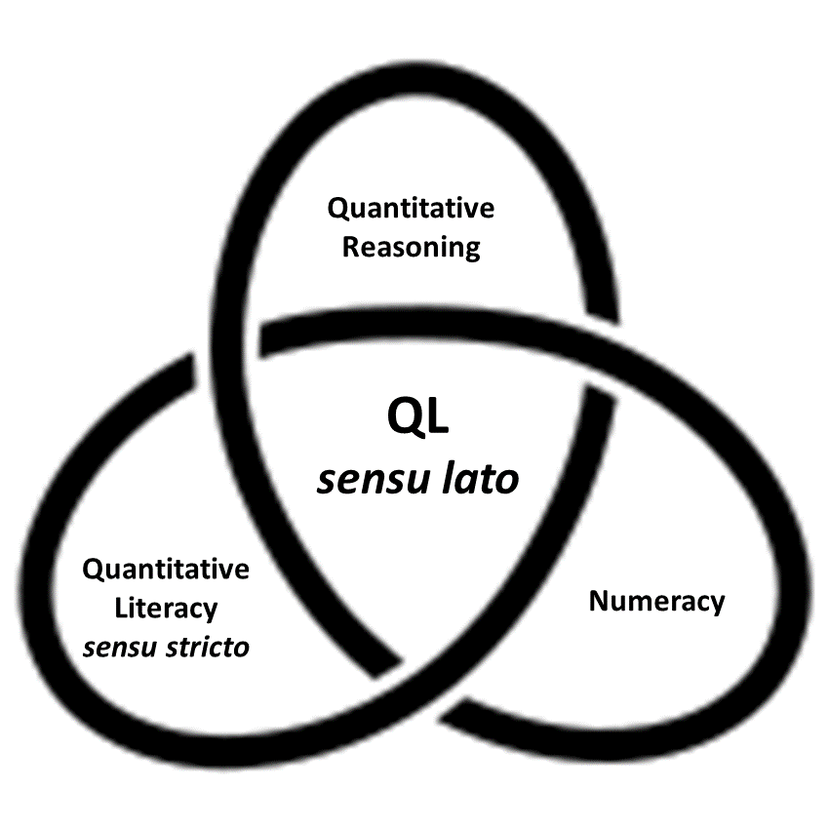
Quantitative Literacy sensu lato
Quantitative Literacy Trefoil Knot

Slide 27
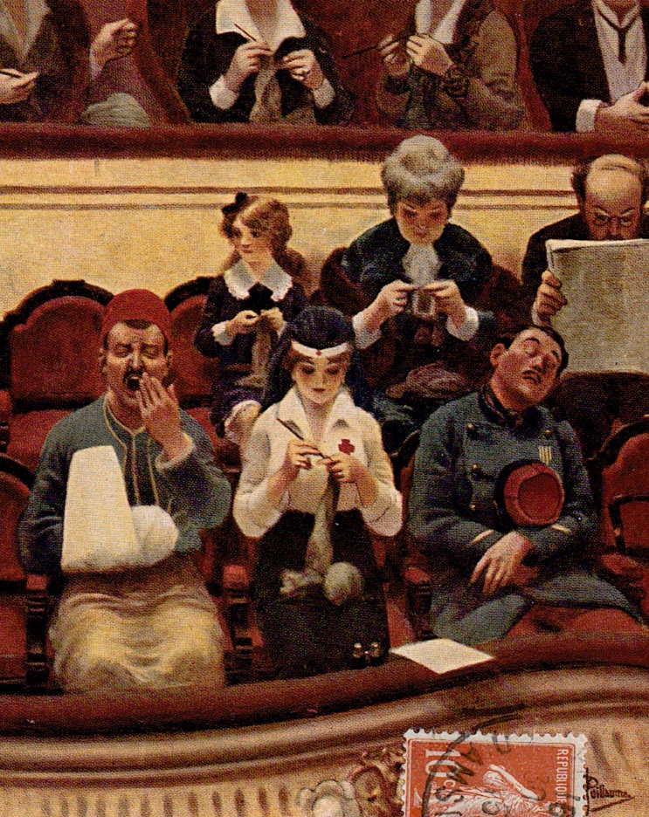
Concluding Remarks
Where do we go from here?
Postcard by Albert Guillaume, public domain

Slide 28
How Much of This Could be Adapted to Other Disciplines?
It’s not just geology, really.

Slide 29
The Ten Commandments of Len
Thou Shalt Not Allow Thine Students to Remain Quantitatively Illiterate!

Slide 30
2016
Ten Principles of Quantitative Literacy as Discussion Points in Computational Geology,
1. Sets enable logic and are the basis of communication.
2. Quantities are more than numbers; they include units.
Counting can be difficult, and measurement introduces uncertainties.
4. Uncertainties propagate through calculation.
5. Ratios (including rates) make comparisons.
6. Exponents speak magnitude.
7. Words underperform our thoughts.
8. Statistics are socially constructed.
9. Statistics reduce data; averages hide information.
10. Models (metaphors) are conditional propositions.

Slide 31
Just how easy is it to write a word problem anyway?

Slide 32
In the words of an alumna –
Why?
$$\frac{3x−7}{9}+x=\frac{3x+7}{3}+1$$

Slide 33
Can you write a reasonable word problem that requires that equation?

Slide 34
One more look:
ricchezza@mail.usf.edu
$$\frac{3x−7}{9}+x=\frac{3x+7}{3}+1$$

Slide 35

Final Questions?
For correspondence: Ricchezza@mail.usf.edu
To find a copy of the presentation: http://vicricchezza.weebly.com/publications/
Or scan the QR code

